Slide 1
Queue Data Structure
Prepared by: Afaq Mansoor Khan
BSSE III- Group A
Session 2017-21
IMSciences, Peshawar.

Slide 2
Last Lecture Summary
Notations
Prefix, Infix and Postfix Notations
Conversion of one type expression to another
Evaluation of Prefix and Postfix Notations

Slide 3
Objectives Overview
Introduction to Queue Data Structure
Types of Queue Data Structures
Circular QUEUE and its Operations
Double Ended QUEUE and its operations

Slide 4
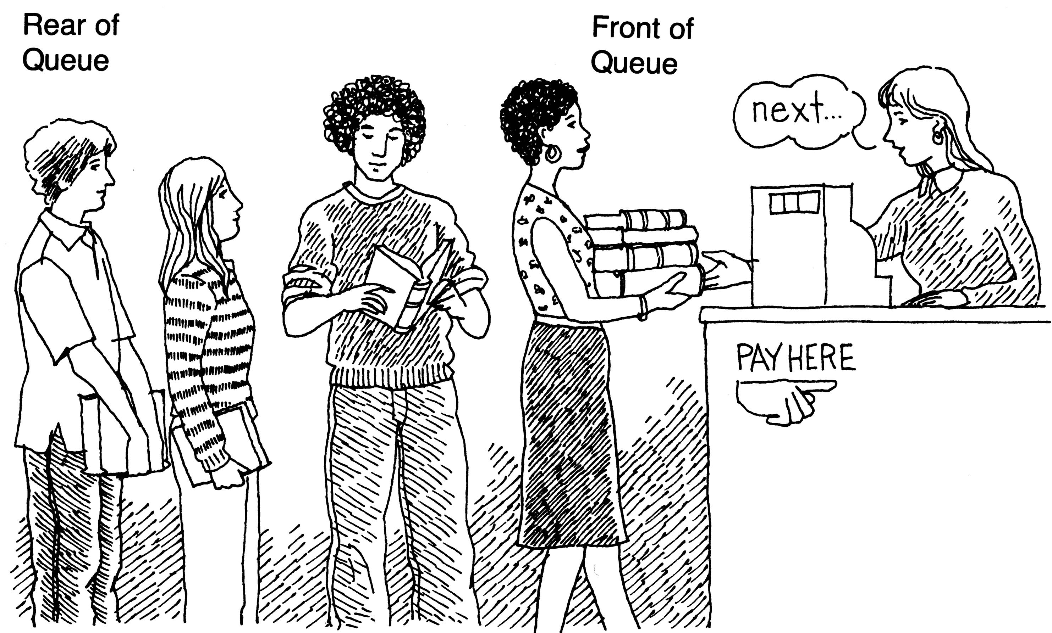
What is a queue?
It is an ordered group of homogeneous items of elements.
Queues have two ends:
Elements are added at one end.
Elements are removed from the other end.
The element added first is also removed first (FIFO: First In, First Out).

Slide 5
Types of Queue
Queue is an abstract data type which can be implemented as a linear or circular list. It has a front and rear. Types of Queue: 1. Simple Queue 2. Circular Queue 3. Dequeue (Double Ended Queue)

Slide 6
Operations on Queue
Mainly the following four basic operations are performed on queue:
Enqueue: Adds an item to the queue. If the queue is full, then it is said to be an Overflow condition.
Dequeue: Removes an item from the queue. The items are popped in the same order in which they are pushed. If the queue is empty, then it is said to be an Underflow condition.
Front: Get the front item from queue.
Rear: Get the last item from queue.

Slide 7
Queue Specification
Definitions: (provided by the user)
MAX_ITEMS: Max number of items that might be on the queue
ItemType: Data type of the items on the queue
Operations
MakeEmpty
Boolean IsEmpty
Boolean IsFull
Enqueue (ItemType newItem)
Dequeue (ItemType)& item)

Slide 8
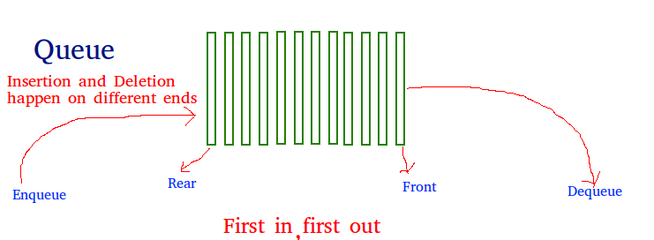

Slide 9

Real World Example

Slide 10
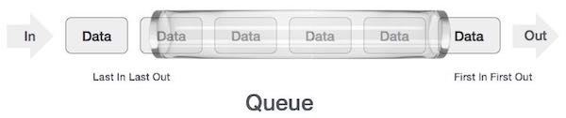
Queue Representation

Slide 11
Enqueue (ItemType newItem)
Function: Adds newItem to the rear of the queue.
Preconditions: Queue has been initialized and is not full.
Postconditions: newItem is at rear of queue.

Slide 12
Enqueue Algorithm
Step 1 − Check if the queue is full.
Step 2 − If the queue is full, produce overflow error and exit.
Step 3 − If the queue is not full, increment rear pointer to point the next empty space.
Step 4 − Add data element to the queue location, where the rear is pointing.
Step 5 − return success.

Slide 13
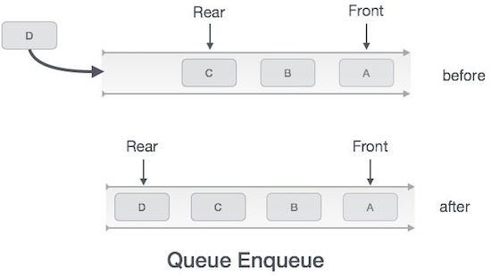
Enqueue Representation

Slide 14
Dequeue (ItemType& item)
Function: Removes front item from queue and returns it in item.
Preconditions: Queue has been initialized and is not empty.
Postconditions: Front element has been removed from queue and item is a copy of removed element.

Slide 15
Dequeue Algorithm
Step 1 − Check if the queue is empty.
Step 2 − If the queue is empty, produce underflow error and exit.
Step 3 − If the queue is not empty, access the data where front is pointing.
Step 4 − Increment front pointer to point to the next available data element.
Step 5 − Return success.

Slide 16
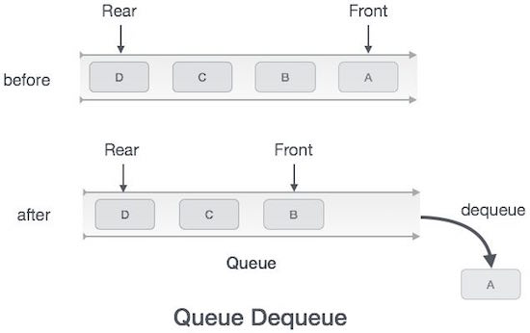
Dequeue Representation

Slide 17
Implementation issues
Implement the queue as a circular structure.
How do we know if a queue is full or empty?
Initialization of front and rear.
Testing for a full or empty queue.

Slide 18
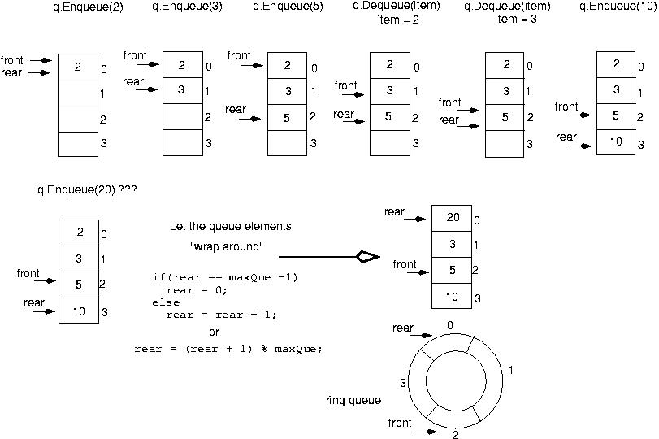

Slide 19
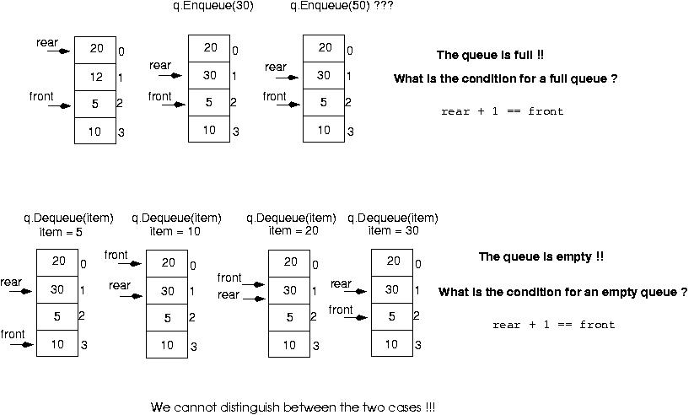

Slide 20
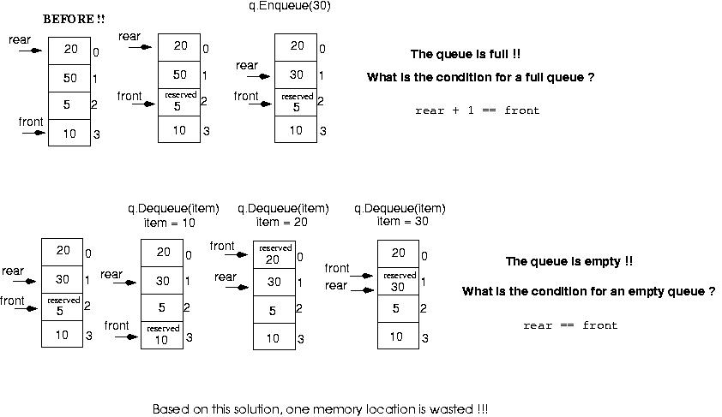
Make front point to the element preceding the front element in the queue (one memory location will be wasted).

Slide 21
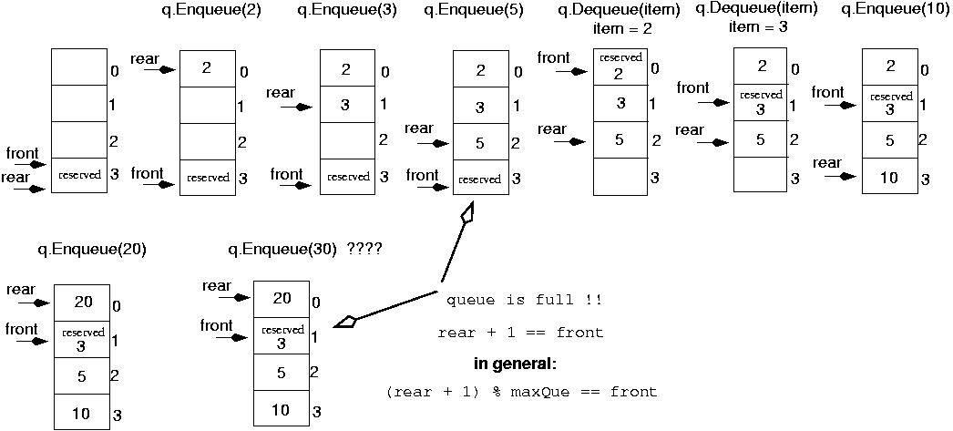
Initialize front and rear

Slide 22
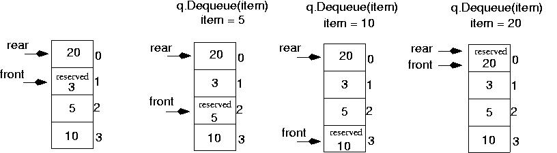
Queue is empty now!!
rear == front

Slide 23
Queue overflow
The condition resulting from trying to add an element onto a full queue.
if(!q.IsFull())
q.Enqueue(item);

Slide 24
Queue underflow
The condition resulting from trying to remove an element from an empty queue.
if(!q.IsEmpty())
q.Dequeue(item);

Slide 25
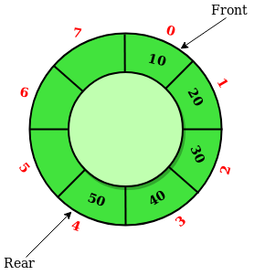
Circular Queue
private:
int front;
int rear;
ItemType* items;
int maxQue;
};
Circular Queue is a linear data structure in which the operations are performed based on FIFO (First In First Out) principle and the last position is connected back to the first position to make a circle. It is also called ‘Ring Buffer’.

Slide 26
Operations on Circular Queue
Front: Get the front item from queue.
Rear: Get the last item from queue.
enQueue(value) This function is used to insert an element into the circular queue. In a circular queue, the new element is always inserted at Rear position.
Steps: Check whether queue is Full – Check ((rear == SIZE-1 && front == 0) || (rear == front-1)).
If it is full then display Queue is full. If queue is not full then, check if (rear == SIZE – 1 && front != 0) if it is true then set rear=0 and insert element.

Slide 27
Operations on Circular Queue
deQueue() This function is used to delete an element from the circular queue. In a circular queue, the element is always deleted from front position.
Steps: Check whether queue is Empty means check (front==-1).
If it is empty then display Queue is empty.
If queue is not empty then step 3
Check if (front==rear) if it is true then set front=rear=-1
else check if (front==size-1), if it is true then set front=0 and return the element.

Slide 28
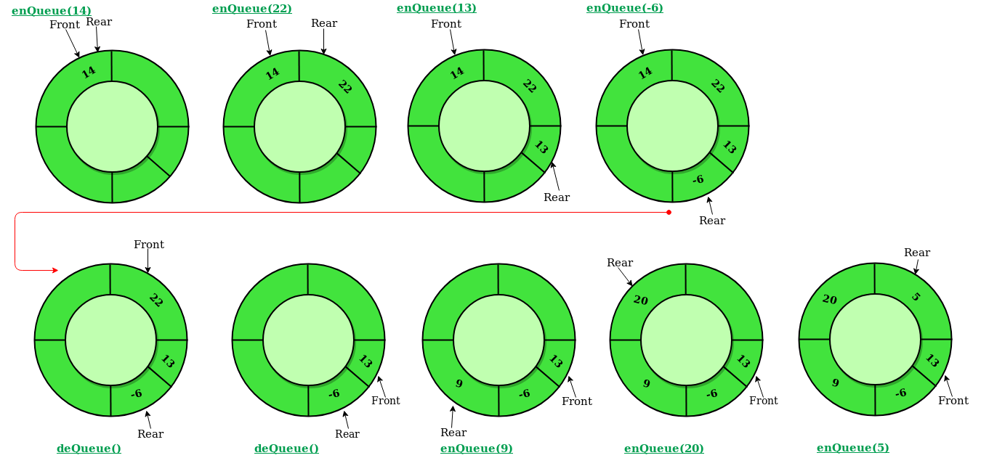

Slide 29
Circular Queue - Implementation
Initialize the queue, with size of the queue defined (maxSize), and head and tail pointers.
enqueue: Check if the number of elements is equal to maxSize - 1:
If Yes, then return Queue is full.
If No, then add the new data element to the location of tail pointer and increment the tail pointer.
dequeue: Check if the number of elements in the queue is zero:
If Yes, then return Queue is empty.
If No, then increment the head pointer.
Finding the size:
If, tail >= head, size = (tail - head) + 1
But if, head > tail, then size = maxSize - (head - tail) + 1

Slide 30
Performance
Time Complexity: Time complexity of all operations like enqueue(), dequeue(), isFull(), isEmpty(), front() and rear() is O(1). There is no loop in any of the operations.

Slide 31
Example: Recognizing Palindromes
A palindrome is a string that reads the same forward and backward.
Able was I ere I saw Elba
We will read the line of text into both a stack and a queue.
Compare the contents of the stack and the queue character-by-character to see if they would produce the same string of characters.

Slide 32
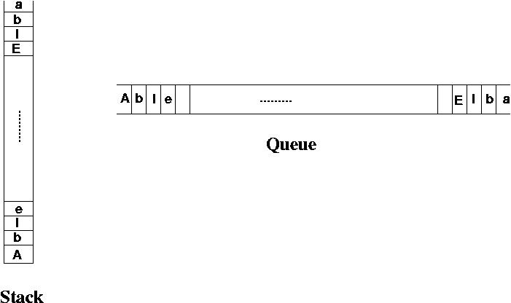
Example: Recognizing Palindromes

Slide 33
Example: Recognizing Palindromes
#include <iostream.h>
#include <ctype.h>
#include "stack.h"
#include "queue.h“
int main()
{
StackType<char> s;
QueType<char> q;
char ch;
char sItem, qItem;
int mismatches = 0;
cout << "Enter string: " << endl;
while(cin.peek() != '\\n') {
cin >> ch;
if(isalpha(ch)) {
if(!s.IsFull())
s.Push(toupper(ch));
if(!q.IsFull())
q.Enqueue(toupper(ch));
}
}

Slide 34
Example: Recognizing Palindromes
while( (!q.IsEmpty()) && (!s.IsEmpty()) ) {
s.Pop(sItem);
q.Dequeue(qItem);
if(sItem != qItem)
++mismatches;
}
if (mismatches == 0)
cout << "That is a palindrome" << endl;
else
cout << That is not a palindrome" << endl;
return 0;
}

Slide 35
Summary
Introduction to Queue Data Structure
Types of Queue Data Structures
Circular QUEUE and its Operations
Double Ended QUEUE and its operations

Slide 36
References
https://www.geeksforgeeks.org/queue-data-structure/
https://www.cse.unr.edu/~bebis/CS308/PowerPoint/Queues.ppt
https://www.tutorialspoint.com/data_structures_algorithms/dsa_queue.htm
https://www.tutorialride.com/data-structures/types-of-queue-in-data-structure.htm

